Slide 1

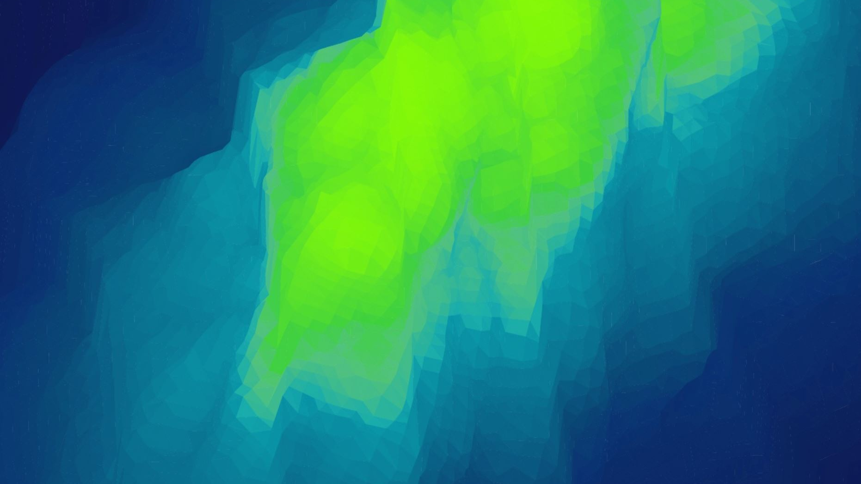
Opportunities and Risk of Nanotechnology in medicine
What is nanotechnology?
Area of material science
1-100 nm in nano-scale
Based on manipulating materials
Valued at USD $54.2 B in 2020
Has medical applications known as nanomedicine
Still in continuous development
Cancer imaging
Diagnosis treatment

Slide 2
Opportunities of Nanomedicine:
Patients being seen by a doctor without going to the clinic or hospital.
Targeted and controlled drug delivery
A lot of possible nano-vehicles can be made
Can pass through the blood-brain barrier
Boost immune responses to vaccines and efficacy of drugs
Boost tissue regeneration
Amplify osseointegration
Help prevent infections

Slide 3
What are the risks involved?
What the future holds?
Offer better patient care
Collaborating with other health sectors
Potentially eliminate cancer
Ability to confront cancer in its molecular level
Personalized medicine
Drugs given only to patients who benefit from it
Nano-based drugs less toxic
Boost efficiency of medicine
Inhaling of nanoparticles can lead to pulmonary inflammation
Nanoparticles assembled in the liver can have lasting effect
Can cause diseases when are not discharged, piling up in the cells and tissue
Can lead to Alzheimer’s or Parkinson disease
Allergic reactions that cause the inflammation of the brain or spinal cord
Phagocytes would be less effective in protecting the body
Harm the body’s immune response to function properly

Slide 4
References:
Andorno, R., & Biller-Andorno, N., (2014). In pursuit of nanoethics. The Risks of Nanomedicine and the Precautionary Principle. 10, 131–145. https://doi.org/10.1007/978-1-4020-6817-1_9
Kimmelman, J. (2012). Beyond human subjects: Risk, Ethics, and Clinical development of nanomedicines. The Journal of Law, Medicine & Ethics,40(4), 841–847. https://doi-org.ezproxy.aut.ac.nz/10.1111%2Fj.1748-720X.2012.00712.x
Paulter, M. & Brenner, S., (2010). Nanomedicine: promises and challenges for the future of public health. International Journal Nanomedicine 803–809. https://www.ncbi.nlm.nih.gov/pmc/articles/PMC2962275/
Resnik, D. B., & Tinkle, S. S. (2007). Ethical issues in Clinical trials involving nanomedicine. Contemporary Clinical Trials, 4(28), 433–441. https://doi.org/10.1016/j.cct.2006.11.001
Riehemann, K., Schneider, S. W., Luger, T. A., Godin, B., Ferrari, M. & Fuchs, H. (2009). Angewandte Chemie. Nanomedicine – Challenge and Perspectives. Pp 872–897. https://doi.org/10.1002/anie.200802585
Tibbals, F. H. (2010). Medical nanotechnology and nanomedicine. Taylor & Francis Group.
Qasim, Muhammad., Lim, Dong-Jin., Park, Hansoo., & Na, Dokyun. (2014). Nanotechnology for diagnosis and treatment of infectious diseases. Journal of Nanoscience and Nanotechnology, 14(10), 7374–7387. https://doi.org/10.1166/jnn.2014.9578
Shiekh, F. A. (2013). Personalized nanomedicine: Future medicine for cancer treatment. International Journal of Nanomedicine, 8(1), 201–202. http://dx.doi.org/10.2147/IJN.S41525
Emerich, D. F., & Thanos, C. G., (2003). Nanotechnology and medicine. Expert Opinion on Biological, 4(3), 655–663. https://doi.org/10.1517/14712598.3.4.655
Walmsley, G. G., McArdle, A., Tevlin, R., Momeni, A., Atashroo, D., Hu, M.S., Feroze, A. H., Wong, V. W., Lorenz, P. H., Longaker, M. T., & Wan, D. C. (2015). Nanomedicine: Nanotechnology, biology and medicine. Science Direct, 11(5), 1253–1263. https://doi.org/10.1016/j.nano.2015.02.013
The Pennsylvania State University. (2018). Introduction to Nanoparticles and Nanostructures [Slides]. Nanohub. https://nanohub.org/resources/22260/download/NACK_U3_Maeder_Nanoparticles_Nanostructures.pdf
Turney, J. (2006). 3. What are the physical and chemical properties of nanoparticles? Europa Public Health. https://ec.europa.eu/health/scientific_committees/opinions_layman/en/nanotechnologies/l-3/3-nanoparticle-properties.htm#0p0
Turney, J. (2009). 2. How can the characteristics of nanomaterials be described and analysed? Europa Public Health. https://ec.europa.eu/health/scientific_committees/opinions_layman/nanomaterials/en/l-3/2.htm
Tzeng Lue, J. (2007). Physical Properties of Nanomaterials. Encyclopedia of Nanoscience and Nanotechnology. Published. http://www.phys.nthu.edu.tw/c_teacher/jtlue/review%20nanomaterials.pdf
Viseu, A. (2021). nanomedicine | Definition, Research, & Applications. Encyclopedia Britannica. https://www.britannica.com/science/nanomedicine

